Slide 1

Milestone 6: Monitoring
Software Engineering
for AI Enabled Systems
Students: Basile Andrea, Iacovazzi Antonio Raffaele, Lorusso Roberto

Slide 2
Agenda
Monitoring at Resource Level
Prometheus
Grafana
Better-Uptime
Monitoring at Performance Level
Locust
Alibi-detector

Slide 3
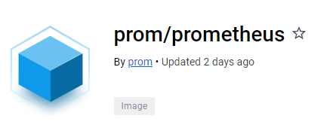
Prometheus-setup
dockerfile
FROM prom/prometheus
COPY prometheus.yml /etc/prometheus/prometheus.yml
> docker pull prom/prometheus: latest
prometheus.yml
global:
scrape_interval: 15s
scrape_timeout: 60s
scrape_configs:
- job_name: 'fastapi'
scrape_interval: 15s
scrape_timeout: 60s
static_configs:
- targets: ['docker.for.mac.localhost:9100']

Slide 4

Grafana-setup
> docker pull grafana/grafana-oss: latest
Grafana OSS (Open Source Software) is the open-source version of Grafana, while Grafana is also available in a paid version called Grafana Enterprise. The Enterprise version offers some additional features compared to the OSS version, such as support for enterprise authentication and integration with other business intelligence tools. In general, Grafana OSS is used by organizations that want a advanced monitoring solution but do not need the features offered by the Enterprise version.

Slide 5
Connect Prometheus & Grafana
Once the docker images have been downloaded, it is possible to modify the docker-compose.yaml
...
prometheus:
container_name: prometheus_container
ports:
- '9300:9090'
build:
context: ./prom
dockerfile: Dockerfile
networks:
- prometheus_grafana
depends_on:
- backend ...
...
grafana:
container_name: grafana_container
image: grafana/grafana-oss
ports:
- '3000:3000'
networks:
- prometheus_grafana
depends_on:
- prometheus
networks:
prometheus_grafana:
The network “Prometheus_Grafana” is addes in order to let the two container to communicate each other.

Slide 6
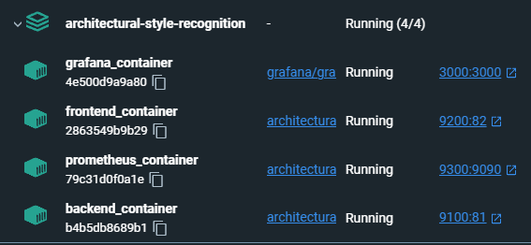
Connect Prometheus & Grafana
Once the docker images have been downloaded, it is possible to modify the docker-compose.yaml
The network “Prometheus_Grafana” is addes in order to let the two container to communicate each other.

Slide 7
Prometheus Metrics
In order to monitor our system we decided to use:
prometheus_fastapi_instrumentator
A configurable and modular Prometheus Instrumentator for your FastAPI.
With this, your FastAPI is instrumented and metrics are ready to be scraped.
The defaults give you:
Counter http_requests_total with handler, status and method. Total number of requests.
Summary http_request_size_bytes with handler. Added up total of the content lengths of all incoming requests.
Summary http_response_size_bytes with handler. Added up total of the content lengths of all outgoing responses.
Histogram http_request_duration_seconds with handler. Only a few buckets to keep cardinality low.
Histogram http_request_duration_highr_seconds without any labels. Large number of buckets (>20).
from prometheus_fastapi_instrumentator import Instrumentator from prometheus_client import (
Counter,
Gauge,
Histogram,
)

Slide 8
Prometheus Metrics
REQUEST_TIME = Gauge(
"request_processing_seconds",
"Time spent processing request",
["method", "endpoint"],
)
AVG_DDFC = Gauge(
"avg_ddfc",
"Average of last 5 'delay detection following change' of the drift detector."
)
hist_img = Histogram(
"img_size",
"Histogram for tracking the size of the images",
buckets=[100,200,300,400,500,600,700,800,900,1000]
)
counter_predictions = Counter(
"counter_predictions",
"Counter for predictions that have been made",
)
counter_labeled_images = Counter(
"counter_labeled_images",
"Counter for images sent to extend the dataset",
)
counter_feedback = Counter(
"counter_feedback",
"Counter for feedbacks sent by the experts",
)

Slide 9
Prometheus Metrics
Furthermore to these metrics we manipulated also other metrics given by the instrumentator as:
Metric A
Metric B
Metric C
At the end we connected Grafana using the Prometheus Container as Data Source and finally we built the dashboard using all the metrics we retained useful for the project.

Slide 10
Grafana Dashboard

